Slide 1
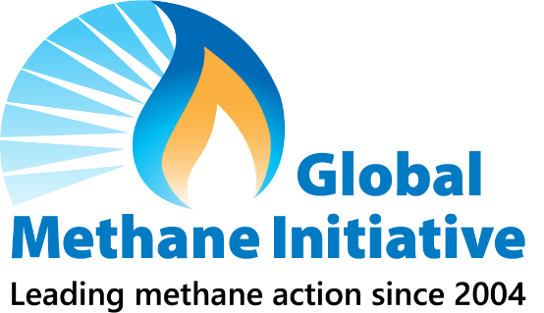

The Global Methane Initiative Policymaker Framework for Addressing Methane & Other Resources
Denise Mulholland
Lead, International Methane Team
Director, Global Methane Initiative Secretariat
US Environmental Protection Agency
6 November 2023

Slide 2
Overview
Climate Change and Methane
The Global Methane Initiative (GMI)
The GMI Policymaker Framework for Addressing Methane Emissions
Other GMI resources and events

Slide 3
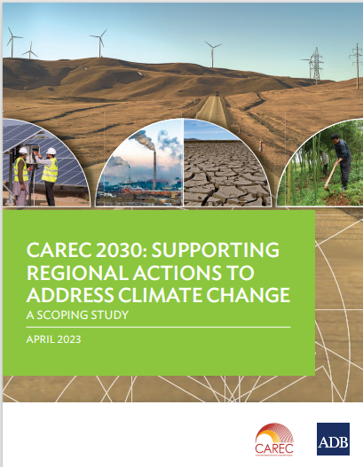
Central Asia and Climate Change
Central Asia is already feeling the effects of climate change, according to a scoping study produced by the Asian Development Bank in 2023:
Water Scarcity:
Over the past 50–60 years, the area of glaciers in Central Asia has decreased by about 30% due to climate change. The volume of freshwater in basins in the region is projected to decrease between 10-40% in the next 75 years
Increased intensity and frequency of storms
The combination of melting snowcaps and intensifying extreme weather events are triggering natural calamities, including the increasing frequency and severity of floods and landslides
Increased Desertification:
The shortage of water resources, increase in air temperature, high variability of precipitation, extreme heat spells, and deforestation lead to increased desertification of the region. ABD estimates that 4%–10% of cultivated areas, 27%–68% of pastures, and 1%–8% of forests are currently significantly degraded in Central Asia and are subject to desertification.
Other Important Considerations
Air pollution is already a challenge for Central Asia with poor air quality in cities, especially in the winter.
  Key sources of air pollution include the burning of fossil fuels for electricity, heat and transportation
The population is growing rapidly which will only increase demand for natural resources
Source: CAREC 2030: Supporting Regional Actions to Address Climate Change, ADB, April 2023
Notes:
Growing water scarcity negatively affects essential economic sectors such as energy, agriculture, and food security, and creating potential conflict.

Slide 4

Why Methane Matters
Positive Outcomes
of Capturing
and Using Methane
Better air and water quality
Improved human health
Increased worker safety
Enhanced energy security
Economic growth
Reduced odors
Methane Emissions
Trap 28 times more heat than carbon dioxide over 100 years
Contribute to ground- level ozone pollution
Create industrial safety problem
Methane Mitigation
Opportunity to capture and convert methane to useful energy
Notes:
Why does methane matter?
Methane is a potent greenhouse gas. Methane's lifetime in the atmosphere is much shorter than carbon dioxide, but it is more efficient at trapping radiation. Pound for pound, the comparative impact of methane is more than 28 times greater than CO₂ over a 100-year period.
Methane is the main precursor of ground level ozone pollution and is also an industrial safety problem.
On the flip side, there are cost effective opportunities and technologies to reduce methane emissions, and there are many benefits to doing so – economically, from an environmental perspective, and from a safety perspective --- including – and Ill just name a few:
Better air and water quality,
Increased worker safety,
Economic growth, and
Reduced odors.
Taking steps to reduce methane in the atmosphere by implementing mitigation options for methane emissions is a critical way to reduce the warming of the climate and as well as the harmful impacts of methane emissions on our communities.

Slide 5
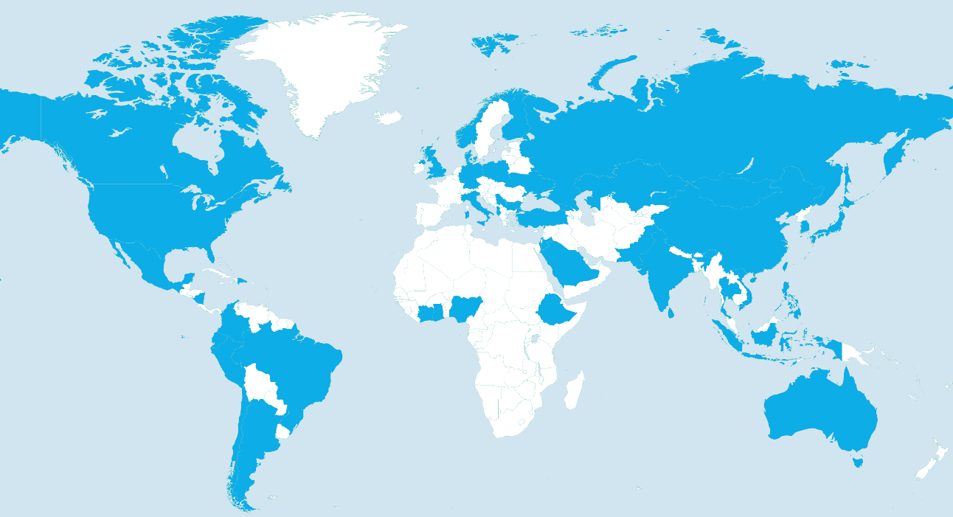
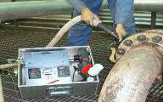
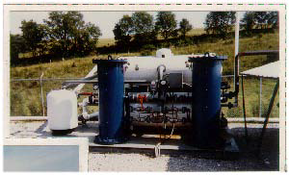
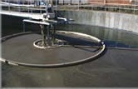
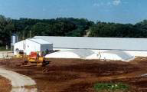
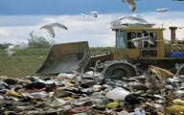
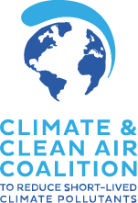




Global Methane Initiative (GMI)
GMI: an international partnership of 47 countries and hundreds of private sector and multilateral partners
Unique expertise, tools, and resources that enable countries to reduce methane quickly and cost-effectively across key sectors:
Municipal Solid Waste
GMI Partner Countries
Oil & Gas Systems
Coal Mines
Wastewater
Agriculture: manure
www.globalmethane.org
Strategic Alliances
Notes:
GMI is an international public-private initiative, launched in 2004 as the Methane to Markets Partnership.
GMI’s mission is to advance cost-effective, near-term methane abatement and recovery and use of methane as a valuable energy source in three sectors: biogas (including agriculture, municipal solid waste, and wastewater), coal mines, and oil and gas systems
The Global Methane Initiative (GMI) has a proven and unparalleled track record of developing and disseminating technical expertise, tools, and resources
GMI has enabled countries to reduce methane quickly and cost-effectively, by working with countries to develop methane mitigation strategies, action plans, policies, tracking methods, and best practices to achieve national level emissions reduction goals.
Since 2004, GMI has partnered with 45 countries and hundreds of private sector and multilateral partners, reducing methane emissions by more than 450 MMTCO₂E.

Slide 6

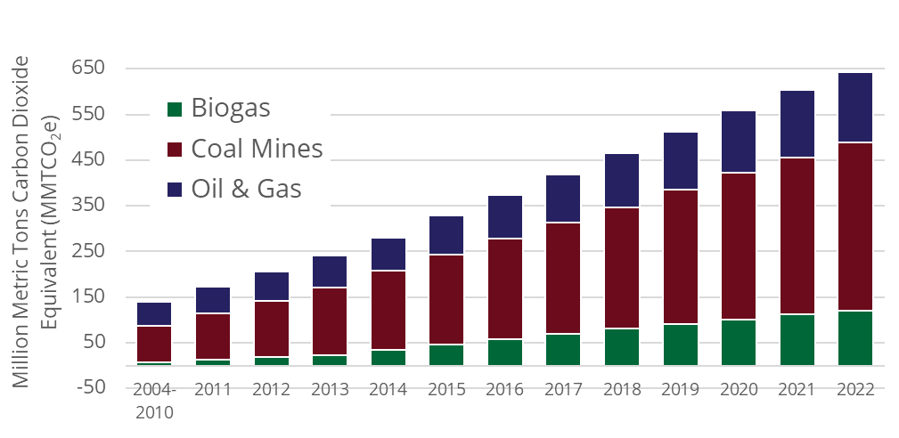








GMI has reduced methane emissions globally
Since 2004, GMI has reduced CH₄ by approximately 643 MMTCO₂e
including approximately 40 MMTCO₂e achieved in 2022
Grown from 14 to 47 Partner Countries
More than $650 million in leveraged funding for projects and training
More than 700 Project Network members
Conducted or developed nearly 2000 assessments, pre-feasibility studies, feasibility studies, study tours, publications, guidances and site visits
643 MMTCO₂e is approximately equivalent* to the CO₂ emissions
from any one of the following:
Provided training for more than 50,000 people on methane mitigation
274 Billion
liters of gasoline consumed
327 Billion
kilograms of coal burned
78 Trillion smartphones charged
Developed more than 60 tools and resources for methane mitigation
* epa.gov/energy/greenhouse-gas-equivalencies-calculator

Slide 7
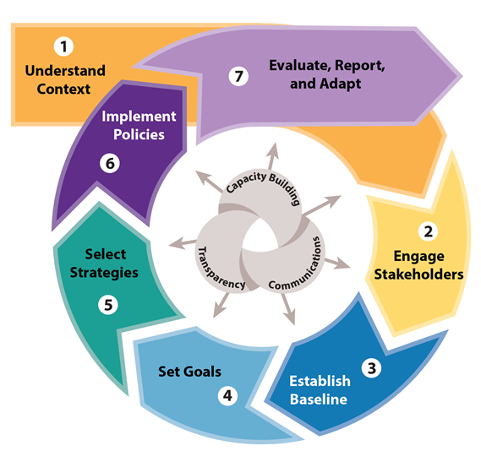
New! GMI Policymaker’s Framework for Addressing Methane Emissions
What: A framework to help countries accelerate progress toward their methane emission reduction goals
How:
  Provides a step-by-step process for developing and implementing policies, programs, and partnerships to reduce methane emissions
  Compiles and organizes available tools, resources and case studies for each of the seven steps
  Outlines three core principles for success
    Capacity building, transparency and communications
Who: Primarily for national policymakers
When: mid-November 2023
Where: www.globalmethane.org

Slide 8
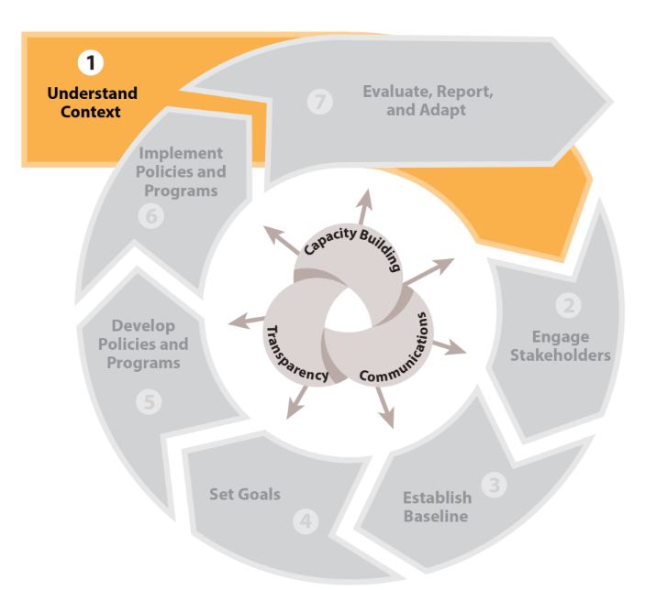
Step 1: Understand Context
Action: Examine the country’s total annual methane emissions and trends, key sources of methane, national and subnational priorities related to the methane-producing sectors, and the current policy and regulatory landscape
Goal: Develop a big-picture understanding of the context for action and priorities
Specific activities:
  Identify national anthropogenic methane emissions sources
  Examine existing national and subnational commitments and related efforts aimed at reducing methane emissions in your country
  Review existing social, environmental, and economic priorities in national strategies or action plans (e.g., National Development Plans)
Notes:
A country’s decision to pursue policies or programs that reduce methane emissions are informed by a multitude of factors, including methane emission sources and trends, methane mitigation actions to date, and sector-specific social, environmental, and economic priorities. The initial step is to “Understand the Context,” which means e

Slide 9
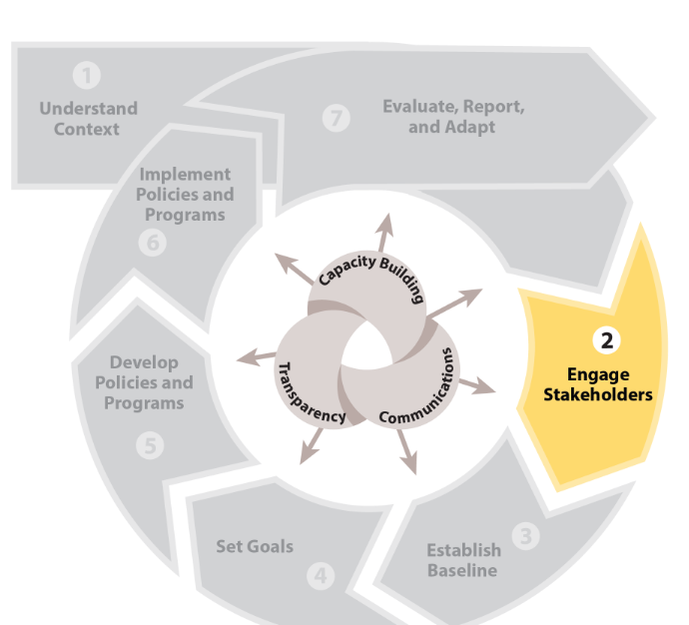
Step 2: Engage Stakeholders
Action: Engage meaningfully with key stakeholders early for long-term success of methane mitigation strategies.
Goal: Solicit input, information and data on policy ideas, feasibility, costs, and impacts; listen to industry and local community concerns; and share information on policy goals, proposals or new rules.
Specific activities can include:
  Identify key stakeholders and document stakeholder roles and responsibilities.
  Select the appropriate type of stakeholder engagement and determine the desired outcomes of engagement.
  Engage with identified stakeholders
  Document interactions

Slide 10
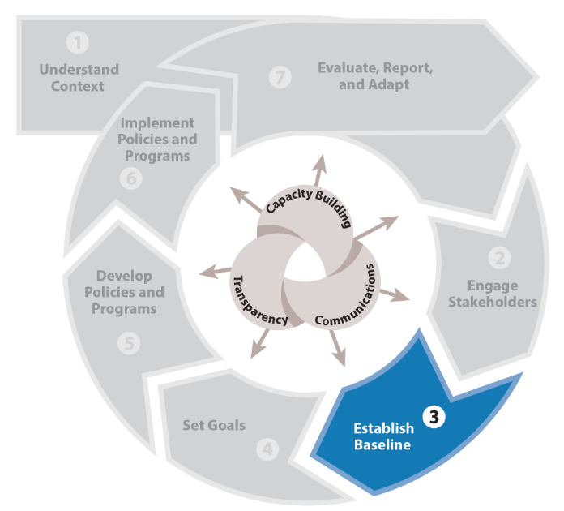
Step 3: Establish Baseline
Action: Estimate baseline emissions—that would occur business-as-usual, in the absence of any policy intervention—for key methane-emitting sectors.
Goal: Understand what emissions would be in the absence of the emission reduction policy to compare against.
Specific Activities can include:
  Review core concepts and components of baselines
  Collect readily available methane emissions data and identify data gaps and limitations.
  Calculate baseline emissions, factoring in current or future law, practices, and technologies that could affect projections.

Slide 11
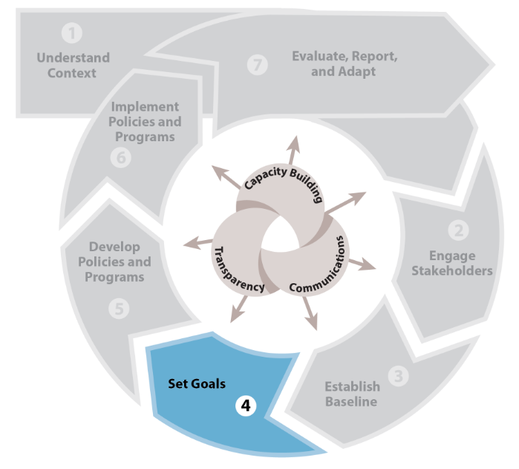
Step 4: Set Goals
Action: Establish goals related to limiting methane
  e.g. from specific source sector, to a specified annual amount by a specified date.
Goal: Ensure goals are realistic with a clearly defined goal boundary, goal type, and timeframe for achievement.
Specific activities can include:
  Consider priorities and previous goals
  Consider the technical feasibility and quantify emission-reduction potential
  Set the parameters of the goal (e.g. geography, sector, format, time frame)
  Communicate with stakeholders and document

Slide 12
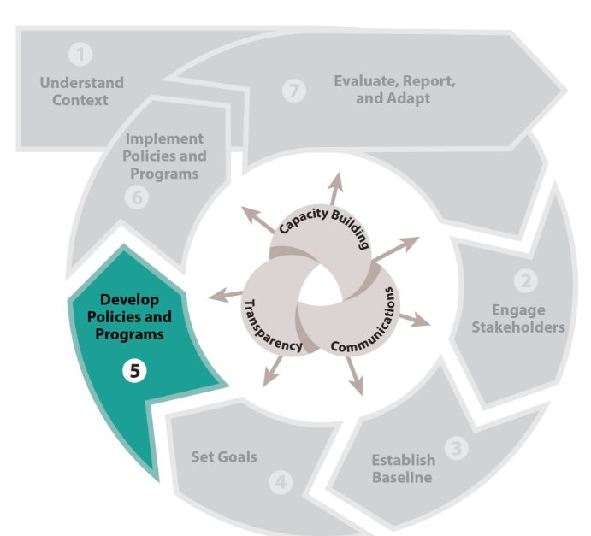
Step 5: Develop Policies and Programs
Action: Identify, analyze, select, and further develop/design the sector- and source-specific strategies
  (e.g. regulatory, voluntary, and incentive-based policies, programs or approaches).
  It may be useful to examine other countries’ strategies and tailor them to meet your own circumstances.
Goal: Design and select strategies most tailored to your priorities and circumstances
Specific Activities can include:
  Identify potential strategies
  Quantify reduction potential
  Estimate costs AND benefits
  Develop and apply criteria, including feasibility

Slide 13
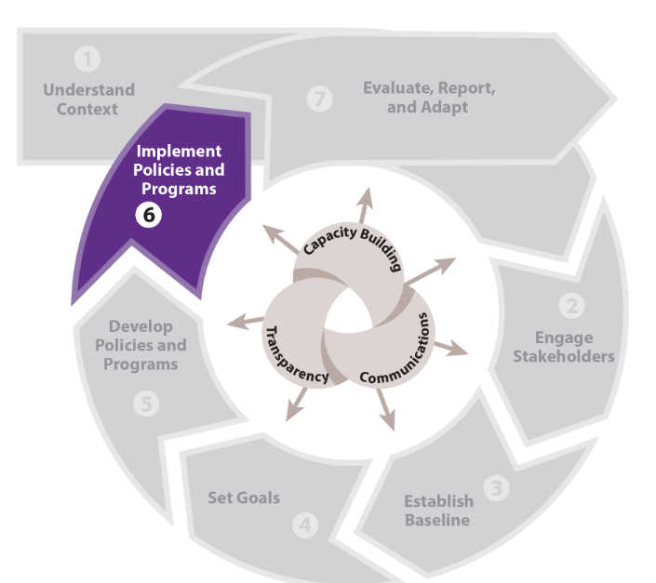
Step 6: Implement Policies and Programs
Action: Implement policies and programs, often in coordination or consultation with agriculture, municipal solid waste, wastewater, oil and gas, or coal mine sector government agencies and key stakeholders.
Goal:
Specific Activities
  Prepare a detailed implementation plan, that identifies the lead ministry or organization responsible
    Establish agreements and frameworks as necessary
    Explore/identify financing sources, as appropriate
  Identify capacity building needs and plan to address
  Engage stakeholders
  Track progress

Slide 14
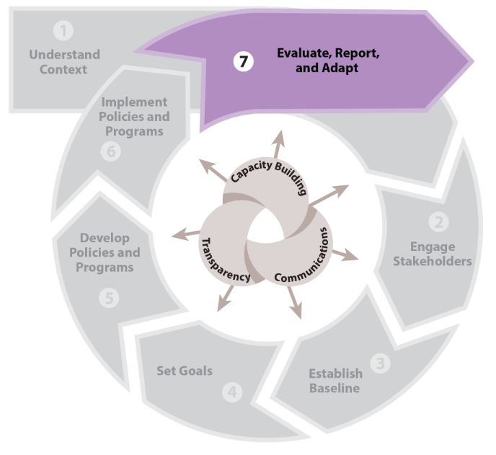
Step 7: Evaluate, Report and Adapt
Action: Measure, report and verify progress on emissions reductions and identify any need to modify policies
Goal: Track progress toward goals and identify areas for improvement
Specific activities can include:
  Determine status of policy implementation
  Calculate and verify emissions reductions
  Gather input from key stakeholders
  Identify adjustments to policies and program(s) needed
  Report progress toward goals

Slide 15
GMI Actions and Resources to Support Methane Reductions
Performs Assessments and Provides Tools | Builds Capacity with Best Practices and Guidance | Fosters peer exchange and information sharing
Desktop studies Site Visits and scoping missions On-site measurement (i.e Pre-Feasibility) studies Leak Detection and Repair Data collection assistance Reports/Technical Presentations/ Guidance Tools/Models Databases on projects Analyses | Mitigation technologies and best practices Best practices and technologies for measurement, reporting and verification (MRV) Guidance to refine emissions inventories Trainings Consultations | Conferences Presentations to Partners and Other Stakeholders Subcommittee Meetings Workshops Webinars Other Meetings
For more information: www.globalmethane.org

Slide 16
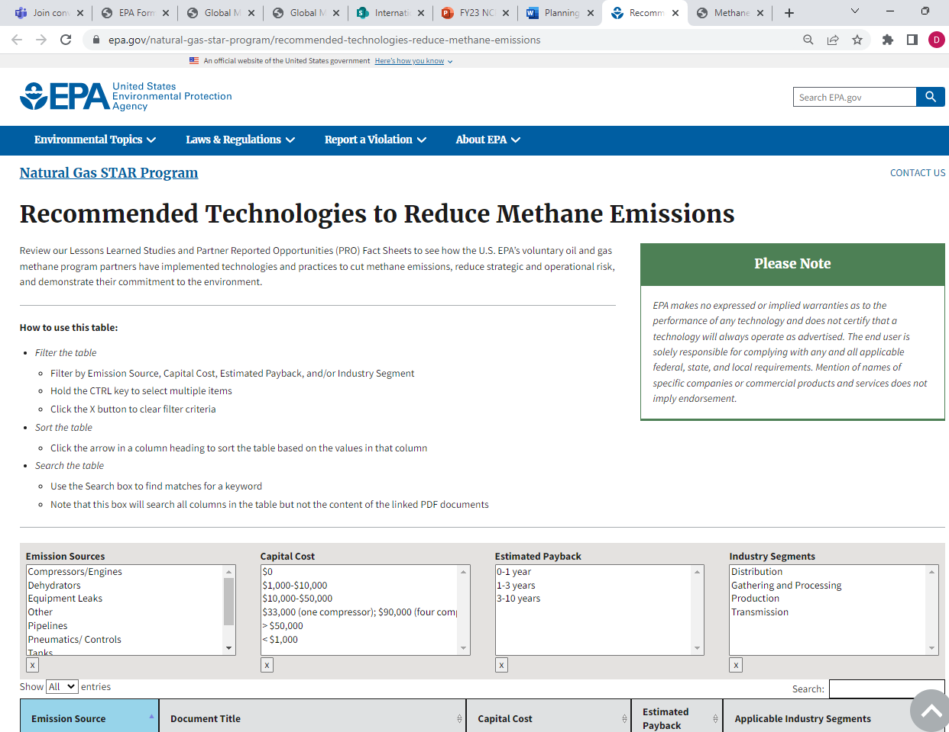
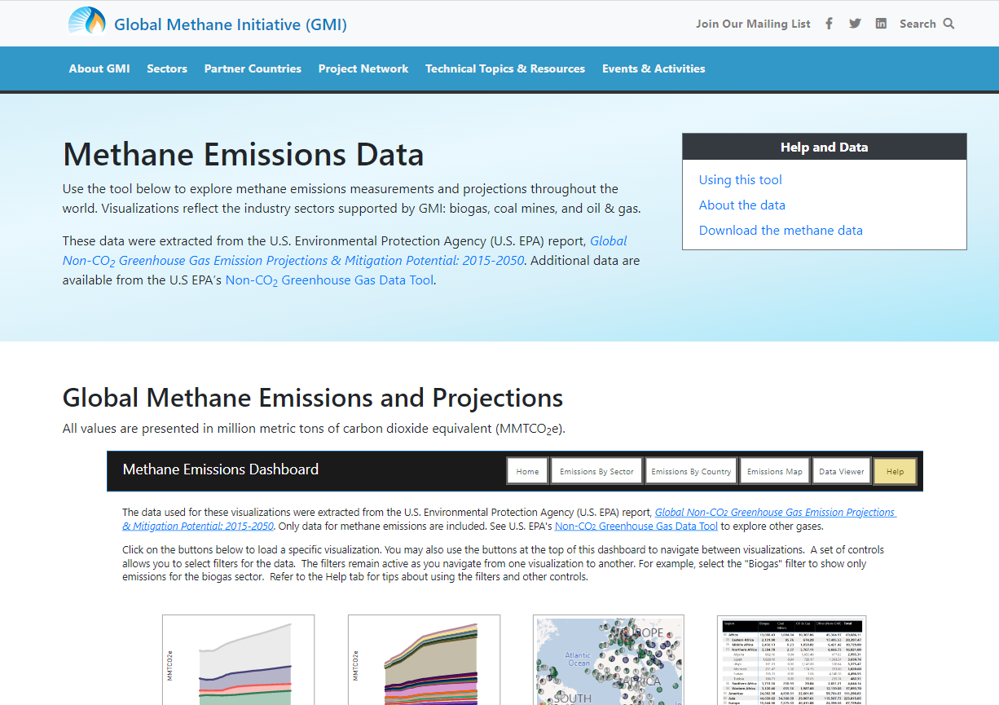
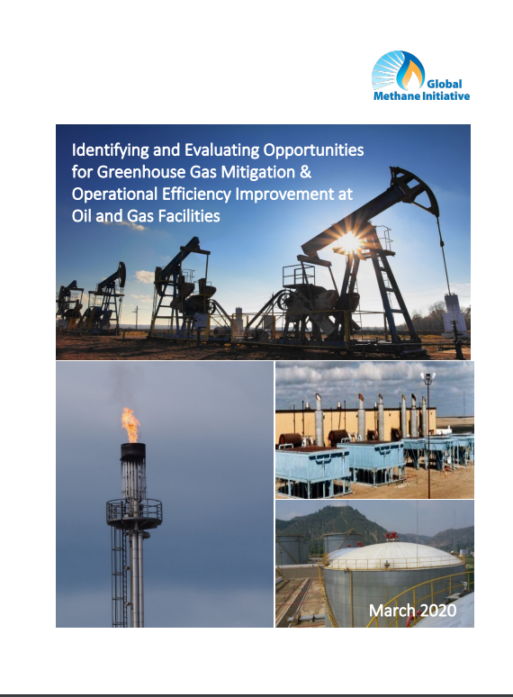
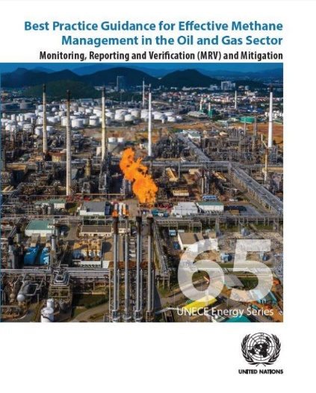
EPA-sponsored GMI Oil & Gas Sector Resources to Support Methane Reductions
Methane Emissions Data Dashboard
EPA’s Recommended Technologies to reduce methane
Identifying and Evaluating Opportunities for Greenhouse Gas Mitigation & Operational Efficiency Improvement at Oil and Gas Facilities (GMI, 2020)
  Introductory guidance on identifying, evaluating, and advancing cost-effective, high-impact opportunities to manage GHG emissions, energy use at O&G facilities.
Best Practice Guidance for Effective Methane Management in the Oil and Gas Sector: Monitoring, Reporting and Verification and Mitigation (UNECE and GMI, 2019)
  Guidance and case studies for facility owners, operators and government policymakers.
Notes:
explore methane emissions measurements and projections throughout the world. Visualizations reflect the industry sectors supported by GMI: biogas, coal mines, and oil & gas.
Review our Lessons Learned Studies and Partner Reported Opportunities (PRO) Fact Sheets to see how the U.S. EPA’s voluntary oil and gas methane program partners have implemented technologies and practices to cut methane emissions, reduce strategic and operational risk, and demonstrate their commitment to the environment.

Slide 17
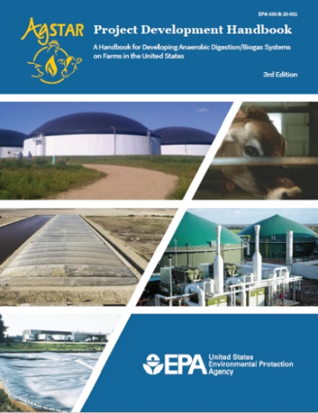
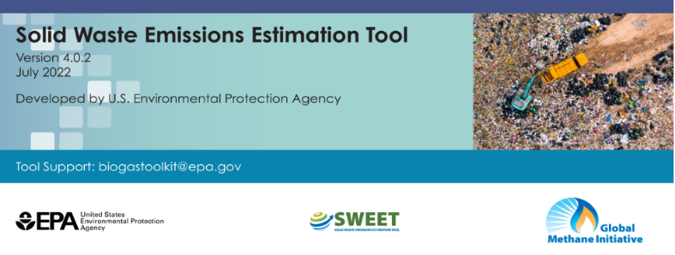
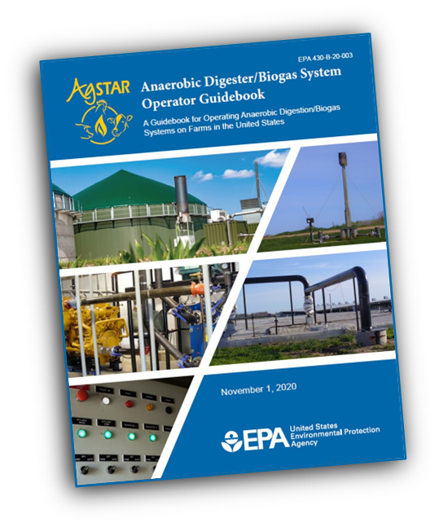
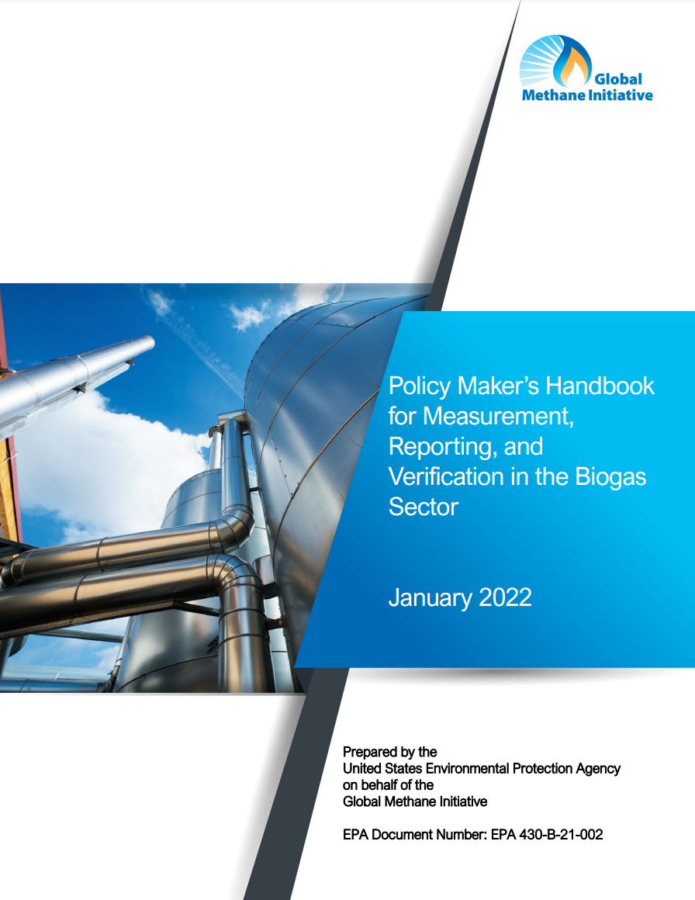
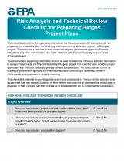
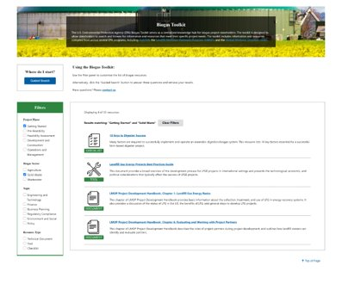
EPA-sponosored GMI Biogas Technical Assistance, Tools, and Resources to Support Methane Reductions
EPA Biogas Toolkit provides a roadmap for planning and implementing projects and quantifying economic and environmental impacts with 38 tools and resources to facilitate biogas project development, including:
  Solid Waste Emissions Estimation Tool (SWEET) Excel-based tool for quantifying pollutant emissions from sources across the waste sector​
  Policymakers’ Handbook on Measurement, Reporting and Verification in the Biogas Sector -High-level resource on guiding principles for conducting emissions MRV for the biogas sector
17

Slide 18
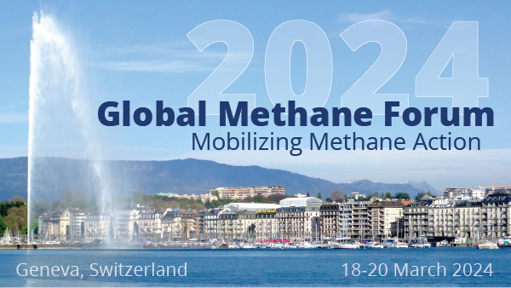
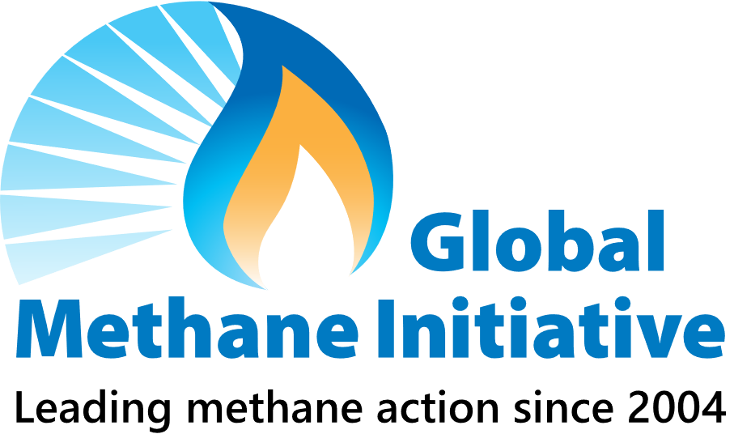



Save the date!
2024 Global Methane Forum: Mobilizing Methane Action
Goals:
  Convene global government, science, industry and finance thought leaders to mobilize ambitious action on methane
  Highlight methane mitigation activities underway to achieve the goals, including of the Global Methane Pledge
  Share information about technical, policy, financing, and regulatory challenges and solutions related to methane policy and project development
Dates and Location:
  18-20 March 2024, UN Palais des Nations, Geneva, Switzerland
Additional information will be posted here:
  https://www.globalmethane.org/2024forum and at https://unece.org/sustainable-energy.
Geneva, Switzerland
Week of 18 March 2024
We look forward to welcoming you in Geneva!
Notes:
This concludes my presentation for today, but I did want to end by sharing an upcoming event, in March 2024.
GMI is co-hosting the upcoming Global Methane Forum with the United Nations Economic Commission for Europe in collaboration with the Global Methane Hub and Climate and Clean Air Coalition.
GMI is co-hosting the Global Methane Forum with the United Nations Economic Commission for Europe.
This Forum is an opportunity for global thought and industry leaders to convene and promote replicable methane mitigation successes and mobilize action to continue making progress toward addressing methane.
More information about the forum will be posted on www.globalmethane.org/2024forum
Please sign up for the GMI Mailing List to receive updates about the forum.
We look forward to welcoming and meeting you in Geneva!

Slide 19
Thank You
Denise Mulholland
Mulholland.Denise@epa.gov

